Slide 1
BITS Pilani

Slide 2
T2- Regular Expressions and Lexer

Slide 3
Example-1
Write a regular expression to recognize a
floating point literal in C language.
[0-9]+\.[0-9]+([e|E][+|-]?[0-9]+)?

Slide 4
Example 2
Some languages, like SQL, have case-insensitive keywords. Write a regular expression for the SQL keyword SELECT.
Ans: [Ss][Ee][Ll][Ee][Cc][Tt]

Slide 5
Example-3
In a new language the designer has chosen the following three rules to generate identifiers.
Rule no1: An Identifier should consist of sequence of letters, digits or underscore beginning with either a letter or underscore.
Rule no2: Identifier must be preceded with any of the following symbols $,@,@@ to indicate global, static and local variables respectively.
Rule no3: Optionally an identifier may end with any of the following characters ?,!, =
Using the three rules mentioned above write a regular expression to accept valid identifiers in this language.
($ |( @ ? @) ) [a-z A-Z _] [a-z A-Z 0-9_]* (\?| ! |=)?

Slide 6
Exercise - 4
Consider the following flex-like lexical specification:
a*b { print "1" }
ca { print "2" }
a*ca* { print "3" }
Given the following input string
abcaacacaaabbaaabcaaca
what does the lexer print?
ab caa ca caaa b b aaab caa ca
132311132
Notes:
http://web.stanford.edu/class/cs143/handouts/midterm17-sol.pdf
Comment example

Slide 7
Exercise - 5
Consider the following flex script:
%%
aa { printf("1"); }
b?a+b? { printf("2"); }
b?a*b? { printf("3"); }
.|\n { printf("4"); }
a. Give an example of an input to this scanner that will produce 123 as an output, or explain why one does not exist.
b. Give an example of an input to this scanner that will produce 321 as an output, or explain why one does not exist.

Slide 8
Exercise - 5
No such input exists. In order for the input to produce 1 at the start, the first two characters must be "aa". Now consider the next character. If it's an 'a,' then, using maximal-munch, the scanner would match rule 2 over rule 1, so 1 wouldn't be printed out. If it's a 'b,' the same is true. If it's anything else, then rule 1 will match "aa," but the next character won't match any of the previous rules, so a 4 will be printed out instead of a 2.
One possible input is bbbabaa. Maximal-munch tokenizes this as bb, bab, aa, which prints 321.

Slide 9
Exercise - 6
Given the following tokens and their associated regular expressions, show what output is produced when this flex
scanner is run over the following strings:*
%%
a*b printf("1");
(a|b)*b printf("2");
c* printf("3");
i. aaabccabbb
ii. cbbbbac
iii. cbabc
The result is 132, with the tokenization aaab cc abbb.
The result is 32a3. The tokenization is c bbbb a c, where the single character
'a' does not match any regular expression and is thus echoed back
to the console.
The result is 323, with tokenization c bab c.
Notes:
https://web.stanford.edu/class/archive/cs/cs143/cs143.1128/handouts/070%20Problem%20Set%201.pdf

Slide 10
Exercise - 7
Consider the following rules written in flex where the brackets are not a part of input but used to specify grouping in flex. Answer questions i to iii.
xx* {return TK_1;}
z(x|y)* {return TK_2;}
xy*z {return TK_3;}
zxx* {return TK_4;}
y*xx*z? {return TK_5;}
i. If the following string is given as input identify the list of tokens generated. xyzxyzxxyyxxzzzxyxzzyy
ii. Considering the input alphabets are {x,y,z}, are there any non-empty strings that do not match any rules? If so, give an example, otherwise explain why?
iii. Is it possible to remove some rule/rules without changing the lexer’s behavior? If yes which rule and why? If not explain why?

Slide 11
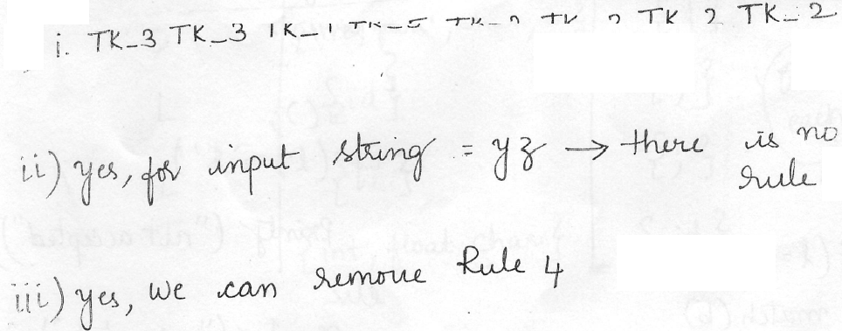
Exercise – 7

Slide 12
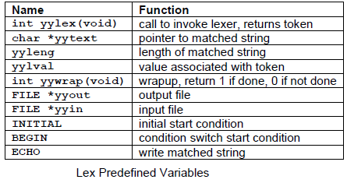
Flex variables

Slide 13
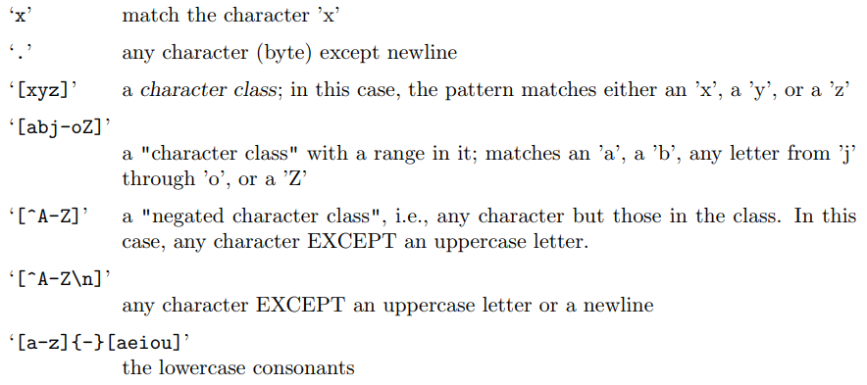
Patterns
The patterns in the input are written using an extended set of regular expressions.

Slide 14
Patterns (contd..)
‘r{2,5}’ anywhere from two to five r’s
‘r{2,}’ two or more r’s
‘r{4}’ exactly 4 r’s
‘\0’ a NUL character (ASCII code 0)
‘\123’ the character with octal value 123
‘\x2a’ the character with hexadecimal value 2a
‘(r)’ match an ‘r’; parentheses are used to override precedence

Slide 15
Patterns (contd..)
In addition to characters and ranges of characters, character classes can also contain character class expressions. These are expressions enclosed inside ‘[’: and ‘:]’ delimiters.
The valid expressions are:
[:alnum:]
[:alpha:]
[:blank:]
[:digit:]
[:lower:]
[:space:]
[:upper:]
These expressions all designate a set of characters equivalent to the corresponding standard C isXXX function.
For example, ‘[:alnum:]’ designates those characters for which isalnum() returns true - i.e., any alphabetic or numeric character.

Slide 16
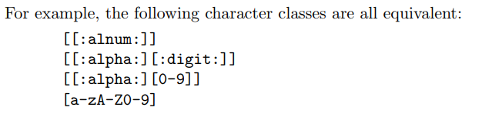
Patterns (contd..)
The ‘{-}’ operator computes the difference of two character classes.
For ex ‘[a-c]{-}[b-z]’ represents all the characters in the class ‘[a-c]’ that are not in the class ‘[b-z]’

Slide 17
Patterns (contd..)
The ‘{+}’ operator computes the union of two character classes.
For example, ‘[a-z]{+}[0-9]’ is the same as ‘[a-z0-9]’.

Slide 18
Exercise – 8 (HW)
As we just saw, r{m, n} in Lex matches anywhere from m to n occurrences of the regular expression r. Write an equivalent regular expression for r{m, n} without using the {…} repetition operator.
Hint: a{1, 4} → a | aa | aaa | aaaa

